Slide 1
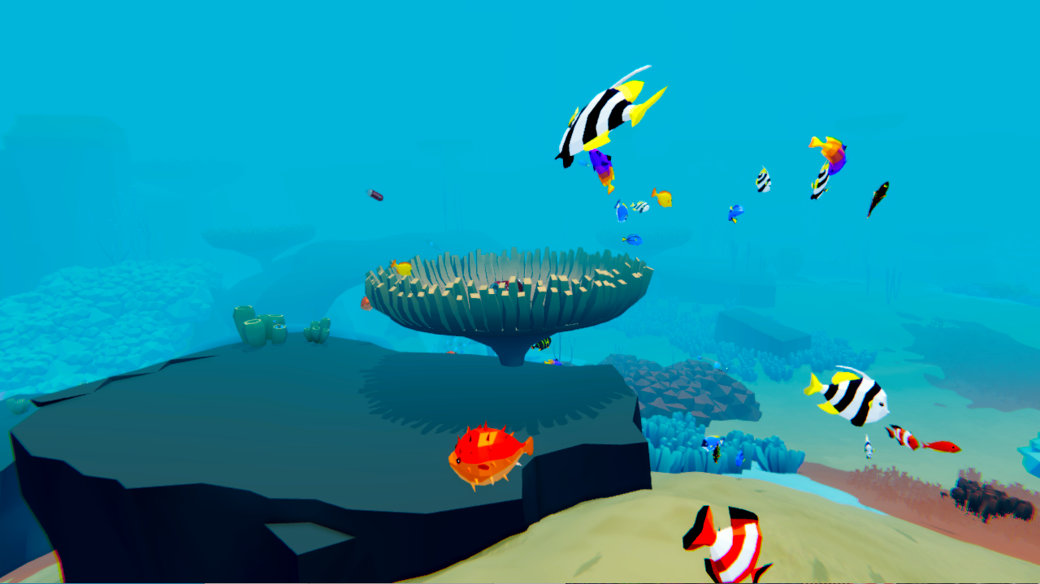
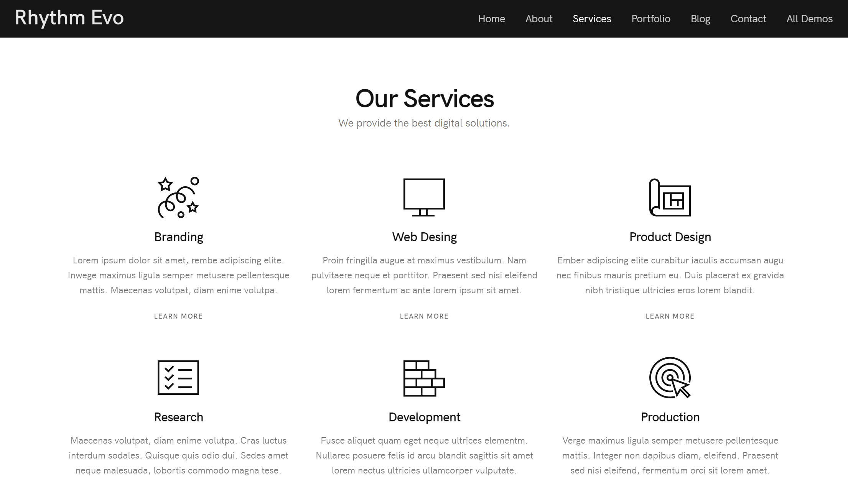
#03, Our Campaign – 02
디자인
Save the fish
Home About Us Our Campaign Blog Contact Donation Privacy Policy
Coral Reef fish | Distant Lands
Screen Ratio 16 : 9

